Slide 1

Predicting Satisfaction Among Students on E-Learning under the Pandemic Situation
R.K.D.I.B. Sandaruwan
(219399L)

Slide 2
Data Collection
Data were collected using Google Forms (https://docs.google.com/forms/d/e/1FAIpQLScZRnPoTwh-_ryIhPpjk1bCI4jbB5vTtep-Vo_LO0sRAw58Ow/formResponse)
Sampling technique was Convenience Sampling
Google form was distributed among undergraduate students in Sri Lanka as possible asked them to mark their response.
1st Section: Covering letter including the purpose of the survey
2nd Section: Demographic Data (12 Questions)
3nd Section: E-learning information questions
Likert Scale questions: Set of 14 Questions categorized into Academic, Psychological, Physical (resources availability) Factors
351 Responses were collected

Slide 3
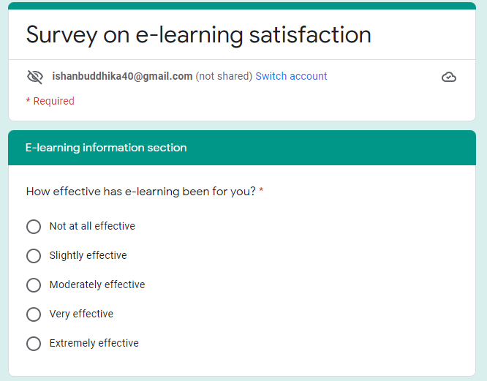
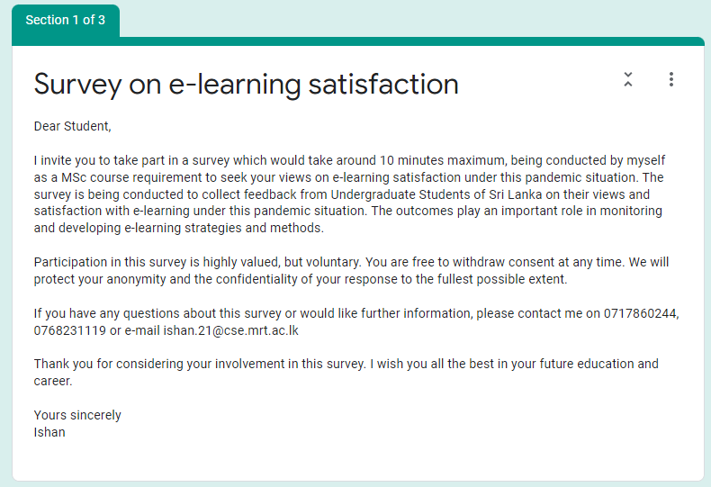
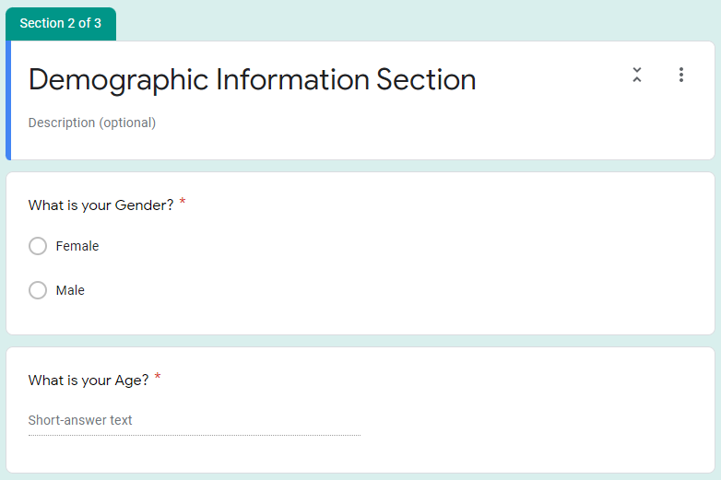
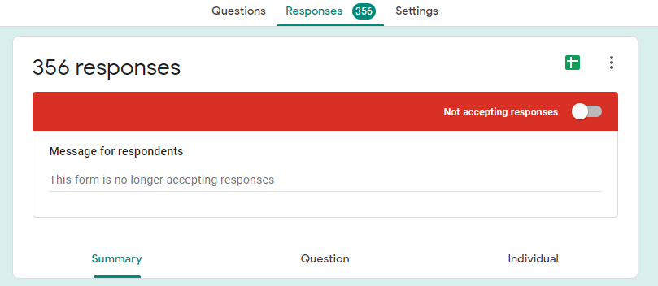
Questionnaire

Slide 4
Methodology
Analysis Sections
Descriptive Analysis
Advanced Analysis
Descriptive Analysis
Frequency tables and Descriptive Graphs
Advanced Analysis
Reliability Analysis
Two sample independent t test
E-learning Satisfaction by Gender
Correlation Analysis
E-learning Satisfaction and Physical Resources Availability, academic assistance, psychological factors
Regression Analysis
Predict E-Learning satisfaction by gender, academic assistance, psychological factors, and physical resources availability

Slide 5
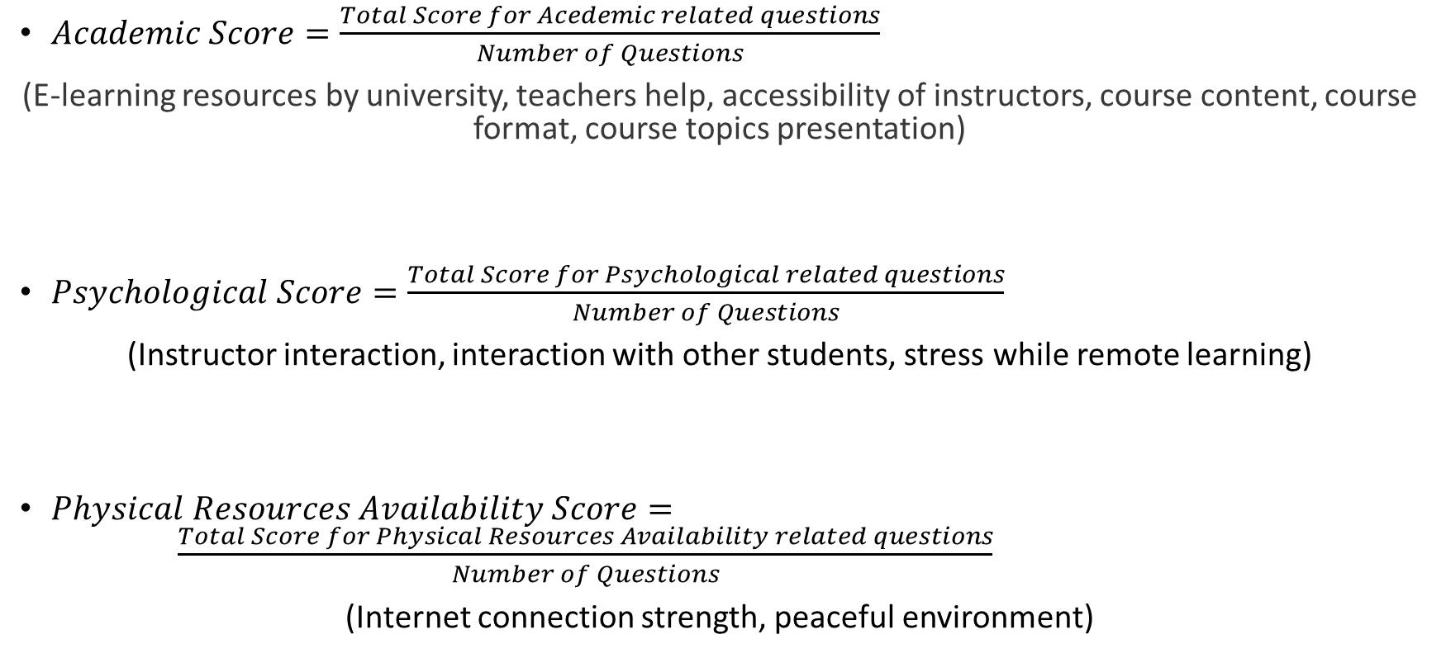
Derivations of Variables
$Academic Score=\frac{Total Score for Acedemic related questions}{Number of Questions}$
(E-learning resources by university, teachers help, accessibility of instructors, course content, course format, course topics presentation)
$Psychological Score=\frac{Total Score for Psychological related questions}{Number of Questions}$
(Instructor interaction, interaction with other students, stress while remote learning)
$Physical Resources Availability Score= \frac{Total Score for Physical Resources Availability related questions}{Number of Questions}$
(Internet connection strength, peaceful environment)

Slide 6
Descriptive Analysis
Attribute | Category | Count | %
Gender
 | Male | 147 | 42%
 | Female | 204 | 58%
Study Location
 | Home | 305 | 87%
 | Café | 5 | 1%
 | Friend's Home | 11 | 3%
 | Public Place | 8 | 2%
 | Relative's Home | 22 | 6%
Mode of Internet Connection
 | Broadband | 21 | 6%
 | Mobile | 38 | 11%
 | Satellite | 3 | 1%
 | Wi-Fi Router | 289 | 82%
Device
 | Desktop | 18 | 5%
 | Laptop | 66 | 19%
 | Tablet | 196 | 56%
 | Smartphone | 71 | 20%
Study Hours (per day)
 | 1-3 hours | 59 | 17%
 | 3-5 hours | 81 | 23%
 | 5-7 hours | 192 | 55%
 | 10+ hours | 19 | 5%
Overall E- Learning Satisfaction
 | Poor | 60 | 17%
 | Fair | 73 | 21%
 | Good | 104 | 30%
 | Very good | 75 | 21%
 | Excellent | 39 | 11%
Most of the respondents in the sample are Females (58%)
Most of the students are studying at their home (87%)
Most of the student’s mode of internet connection is Wi-Fi router (82%).
Most of the students in the sample study 5-7 hours per day on average (55%).
Only 5% of the students study more than 10 hours per day on average.
Most of the students in the sample are satisfied with e-learning (Good, Very Good, and Excellent) (62%).

Slide 7
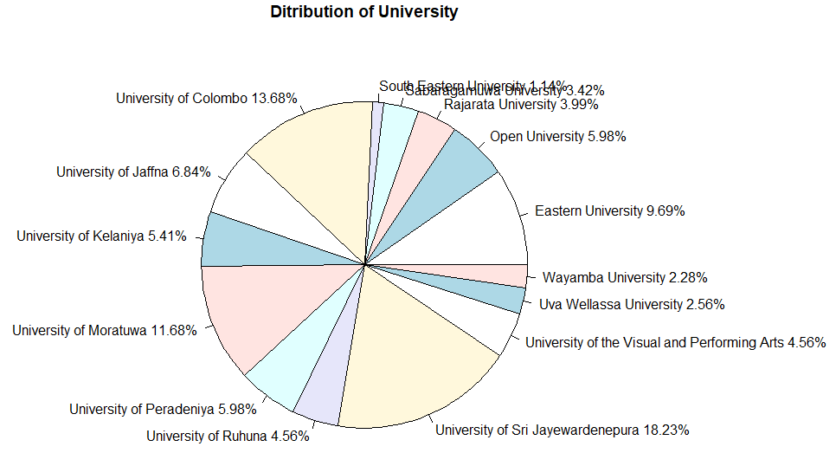
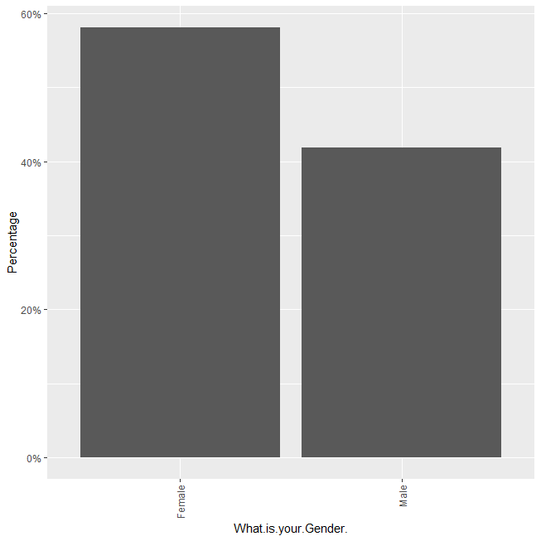
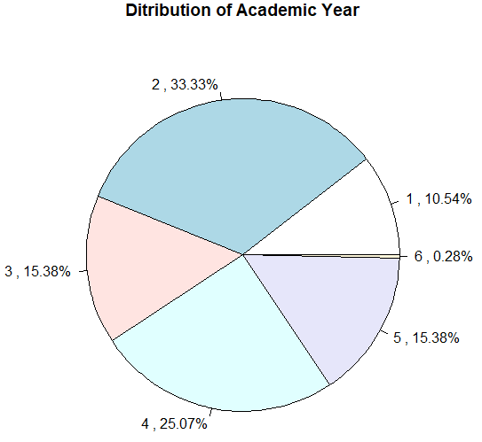
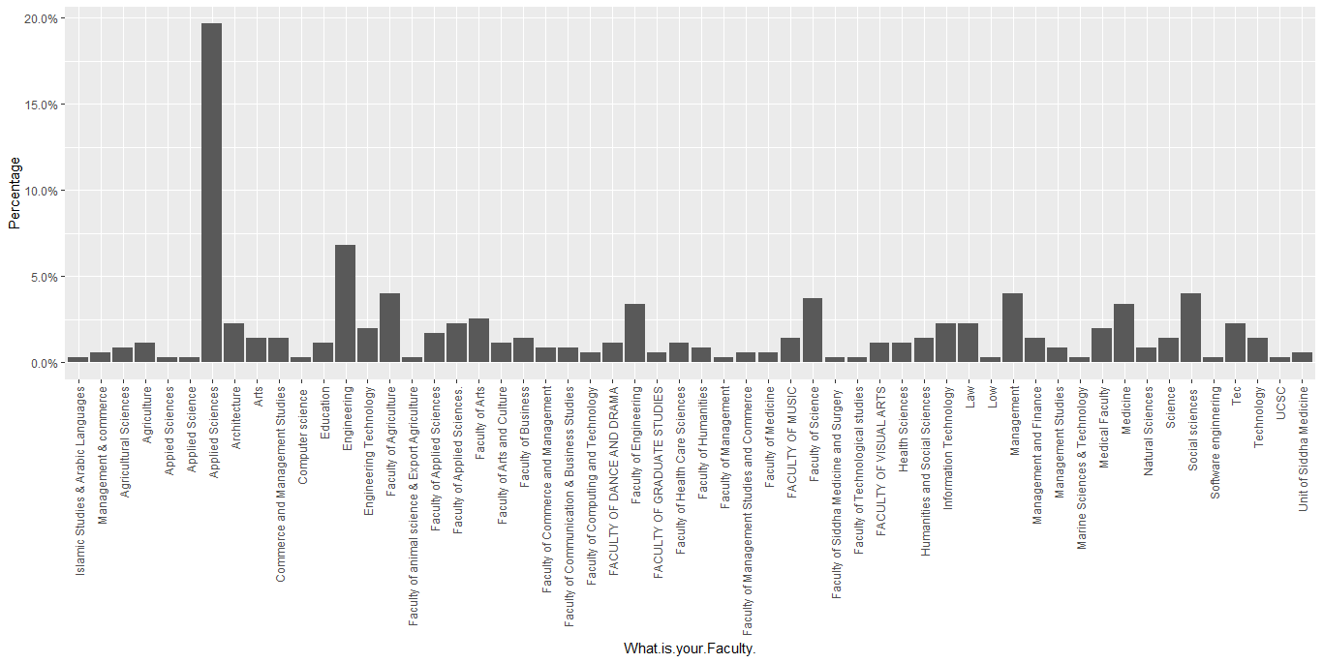
Descriptive Analysis

Slide 8
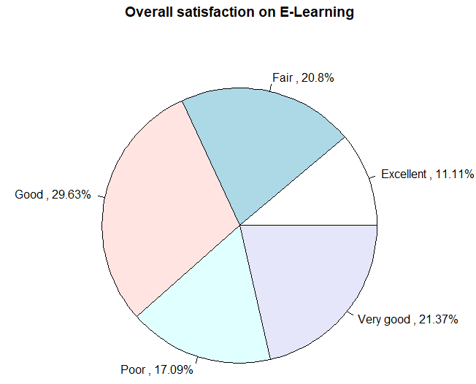
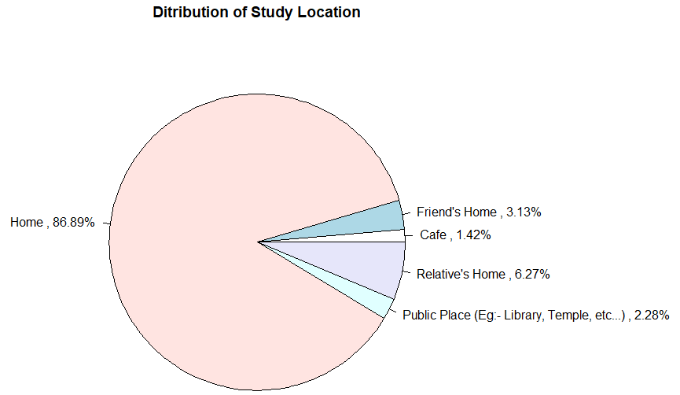
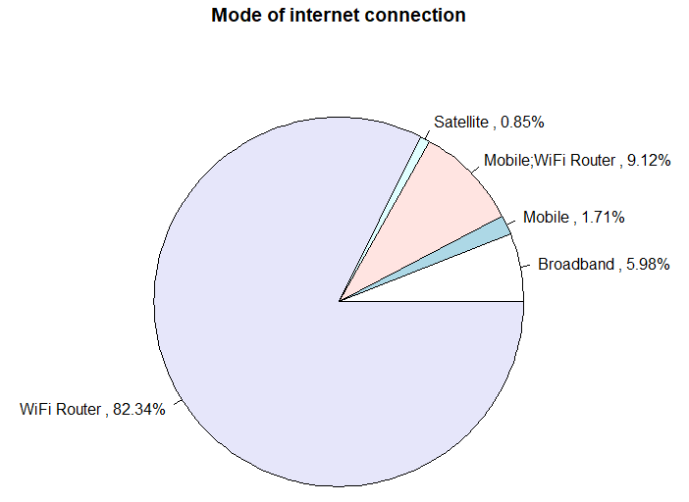
Descriptive Analysis

Slide 9
Advanced Analysis
Reliability Analysis
Reliability of responses related to all three Academic Factors, physical resource availability and Psychological factors were satisfactory since all measures are greater than minimum acceptable threshold value (0.7)
Factor | Questions | Conbranch Alpha
Academic Factors | 6 | 0.75
Psychological Factors | 3 | 0.796
Physical Resources Availability Factors | 2 | 0.703

Slide 10
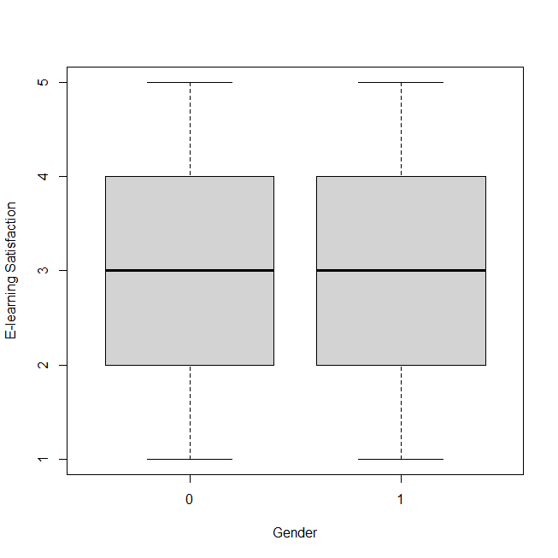
Advanced Analysis
E-learning satisfaction by Gender
Hypothesis Testing
H0: There is no difference in satisfaction on e-learning by gender
H1: There is a difference in satisfaction on e-learning by gender
t = -34.594, df = 458.15, p-value < 2.2e-16
Since P value is less than 0.05, null hypothesis rejected at 0.05 level of significance.
Therefore there is a difference in satisfaction on e-learning by gender
Females have higher satisfaction on E-learning than males on average

Slide 11
Correlation Analysis
 | Overall satisfaction | P Value
Overall satisfaction | 1
Academic score | -0.031 | 0.5601
Psychological Score | 0.003 | 0.9627
Physical Resources Availability Score | 0.273 * | 2.09E-07
* significant at 0.05 sig. level
There is significant week positive linear relationship between overall satisfaction and physical resources availability score

Slide 12
Predicting E-learning satisfaction
Linear regression was used
Response Variable: Overall E-learning Satisfaction Score
Predictor Variables: Gender, Academic score, Psychological Score, Physical Resources Availability Score
Fitted regression model was significant (F(3,346) = 9.188, p < .05) and can be used for predictions
Residual standard error | 1.187
DF | 346
Multiple R-squared | 0.09602
Adjusted R-squared | 0.08557
F-statistic (4, 346) | 9.188
P-value | 4.59E-07

Slide 13
Predicting E-learning satisfaction
 | Estimate | Std. Error | t value | Pr(>|t|) | 95 % CI
(Intercept) | 2.35787 | 0.36096 | 6.532 | 2.32E-10 | (1.648,3.068)
Gender | -0.35312 | 0.1469 | -2.404 | 0.0167 | (-0.642,-0.064)
Academic score | -0.02767 | 0.09276 | -0.298 | 0.7657 | (-0.21,0.155)
Psychological Score | -0.0271 | 0.0961 | -0.282 | 0.7781 | (-0.216,0.162)
Physical Resources Availability Score | 0.45649 | 0.07765 | 5.879 | 9.74E-09 | (0.304,0.609)
Gender and Physical Resources Availability Score were significant predictors when predicting E-learning satisfactions among undergraduate students in Sri Lanka
E learning satisfaction score for the males is 0.35 less than E learning satisfaction score for the females (95% confidence interval is (0.064, 0.642)).
E learning satisfaction score increased by 0.46 on average when Physical Resources Availability Score increased by 1 unit (95% confidence interval is (0.304,0.609)).

Slide 14
Recommendations
Take special measures to increase E-learning satisfaction for males.
Ensure the peaceful environment for the students for E-learning
Making arrangements to ensure strong internet connection for the students for E-learning

Slide 15
Thank You ☺

